Slide 1
1.2 Multimedia - Graphics
show understanding of how data for a bitmapped image is encoded
use the terminology associated with bitmaps: pixel, file header, image resolution, screen resolution
perform calculations estimating the file size for bitmapped images of different resolutions
show understanding of how data for a vector graphic is represented and encoded
use the terminology associated with vector graphics: drawing object, property and drawing list
show understanding of how typical features found in bitmapped and vector graphics software are used in practice
justify where bitmapped graphics and/or vector graphics are appropriate for a given task

Slide 2
Today
show understanding of how data for a bitmapped image is encoded
use the terminology associated with bitmaps: pixel, file header, image resolution, screen resolution
Understand: How to use binary to get an image
Able: Create your own image via binary
Answer: How can you get red if all you have is grey?

Slide 3
Bitmap
What’s a map?
A drawing of locations, usually used to guide you.
What’s a bit
Binary 1 or Binary 0
What’s a bitmap?
A map of 1’s and 0’s
Used for images

Slide 4
Bitmap Images
Sometimes called Raster Images
Made up from pixels. (Kind of)
Pixel = Picture Element. A single illuminated dot.
Photo realistic
Photo realistic = Looks like real life

Slide 5
Flower
Here is a photo of a flower
It looks like a real flower
Zoomed in you can see its actually a lot of little squares.
But our stupid human eyes cannot see the little squares without zooming in. We just see a perfect flower.
This is how a bitmap image works.
Lots of little squares.

Slide 6
Questions
Questions:
Is a square a pixel?
How big is a square?
How do you know what to put in a square?
Is there a better way to represent it?

Slide 7
Is a square a pixel?
We said bitmap are made of pixels….
We saw, with the flower, that it’s a lot of little squares
So is a square a pixel? Pick the correct answer from the 5 choices below.
No, they are not the same.
Nope, not the same
A square and pixel are different
A pixel is a dot and a square is a square so they are different.
I cannot believe you made 5 ways to say a pixel and a square are different.

Slide 8
Why are they not the same.
Many books and websites say the squares and pixels are the same. Pixel is a dot, square is a square so what the difference.
A pixel has no fixed size, you can get big pixels, small pixels, medium pixels. But a square is 8 x 8 pixels.
So if you have small pixels it might look like:
But if you use larger pixels, then your square will look like:
Both are still 8x8
So one 8x8 square = 1 pixel

Slide 9
How to draw a bitmap
Let’s say you want the letter A
Every white square is a 0 and every black square is a 1 (for now. In real life every white square is 1 and black is 0)

Slide 10
Bitmap in Binary
0 | 0 | 1 | 1 | 1 | 0 | 0 | 0
0 | 1 | 0 | 0 | 0 | 1 | 0 | 0
0 | 1 | 0 | 0 | 0 | 1 | 0 | 0
0 | 1 | 0 | 0 | 0 | 1 | 0 | 0
0 | 1 | 1 | 1 | 1 | 1 | 0 | 0
0 | 1 | 0 | 0 | 0 | 1 | 0 | 0
0 | 1 | 0 | 0 | 0 | 1 | 0 | 0
0 | 0 | 0 | 0 | 0 | 0 | 0 | 0
So if we look at the top row, its 00111000 Then its 01000100
Then the next row is 01000100
And so on.
That’s it…. Kind of…. There are two more things we need to sort out.
1. How to count
2. How to colour
And also, really white should be 1 and black should be 0

Slide 11
Bitmap in Hex
0 | 0 | 1 | 1 | 1 | 0 | 0 | 0
0 | 1 | 0 | 0 | 0 | 1 | 0 | 0
0 | 1 | 0 | 0 | 0 | 1 | 0 | 0
0 | 1 | 0 | 0 | 0 | 1 | 0 | 0
0 | 1 | 1 | 1 | 1 | 1 | 0 | 0
0 | 1 | 0 | 0 | 0 | 1 | 0 | 0
0 | 1 | 0 | 0 | 0 | 1 | 0 | 0
0 | 0 | 0 | 0 | 0 | 0 | 0 | 0
We can count in hexadecimal.
One hex digit is 4 binary digits
So if we look at the first row:
Binary is 00111000 That’s 8 binary digits, so we can split it into 4 bits and 4 bits
0011 and 1000
So we can say the first row is 3 8 in hex
0 | 0 | 1 | 1 | 1 | 0 | 0 | 0
0 | 1 | 0 | 0 | 0 | 1 | 0 | 0
0 | 1 | 0 | 0 | 0 | 1 | 0 | 0
0 | 1 | 0 | 0 | 0 | 1 | 0 | 0
0 | 1 | 1 | 1 | 1 | 1 | 0 | 0
0 | 1 | 0 | 0 | 0 | 1 | 0 | 0
0 | 1 | 0 | 0 | 0 | 1 | 0 | 0
0 | 0 | 0 | 0 | 0 | 0 | 0 | 0
 | 2³ | 2² | 2¹ | 2⁰ | In Decimal | In Hex
Value | 8 | 4 | 2 | 1
Red Binary Half | 0 | 0 | 1 | 1 | 3 | 3
Blue Binary Half | 1 | 0 | 0 | 0 | 8 | 8

Slide 12
What’s this image in Binary and Hex?

Slide 13
What’s this image in Binary and Hex?
2³ | 2² | 2¹ | 2⁰ | Dec | Hex | 2³ | 2² | 2¹ | 2⁰ | Dec | Hex
8 | 4 | 2 | 1 |  |  | 8 | 4 | 2 | 1
0 | 1 | 1 | 1 | 7 | 7 | 1 | 1 | 1 | 0 | 14 | E
0 | 1 | 0 | 0 | 4 | 4 | 0 | 0 | 1 | 0 | 2 | 2
0 | 1 | 1 | 1 | 7 | 7 | 1 | 1 | 1 | 0 | 14 | E
1 | 1 | 0 | 0 | 12 | C | 0 | 0 | 1 | 1 | 3 | 3
1 | 0 | 0 | 0 | 9 | 9 | 0 | 0 | 1 | 1 | 3 | 3
1 | 1 | 1 | 1 | 15 | F | 1 | 1 | 1 | 1 | 15 | F
0 | 0 | 1 | 1 | 3 | 3 | 1 | 1 | 0 | 0 | 12 | C
0 | 0 | 1 | 1 | 3 | 3 | 1 | 1 | 0 | 0 | 12 | C
0 | 1 | 1 | 1 | 1 | 1 | 1 | 0
0 | 1 | 0 | 0 | 0 | 0 | 1 | 0
0 | 1 | 1 | 1 | 1 | 1 | 1 | 0
1 | 1 | 0 | 0 | 0 | 0 | 1 | 1
1 | 0 | 0 | 0 | 0 | 0 | 1 | 1
1 | 1 | 1 | 1 | 1 | 1 | 1 | 1
0 | 0 | 1 | 1 | 1 | 1 | 0 | 0
0 | 0 | 1 | 1 | 1 | 1 | 0 | 0

Slide 14
Too easy
So we can tell what the binary and hex values are for a bitmap image…But….
What numbers did we use for our Black ’A’?
0 and 1. Only used 2 numbers, only 2 colours, so its called a 1 bit image
WTF is it called a 1 bit image when it has 2 colours (black and white)
Because 2¹ = 2 (colours)

Slide 15
Colour Depth / Colour Bit
1 bit = 2¹ = 2 colours
2 bit = 2² = 4 colours
4 bit = 2⁴ = 16 colours
8 bit = 2⁸ = 256 colours
16 bit = 2¹⁶ = 65,536 colours
24 bit = 2²⁴ = 16,777,216 colours
32 bit = 2³² = 4,294,967,296 colours

Slide 16
24 bit 2²⁴ = 16, 777, 216 colours
8 bit 2⁸ = 256 colours

Slide 17
7 bit 2⁷ = 128 colours
6 bit 2⁶ = 64 colours

Slide 18
5 bit 2⁵ = 32 colours
4 bit 2⁴ = 16 colours

Slide 19
3 bit 2³ = 8 colours
2 bit 2² = 4 colours

Slide 20
24 bit 2²⁴ = 16,777,216 colours
1 bit 2¹ = 2 colours

Slide 21
So how do you do colour?
0 | 0 | 1 | 1 | 1 | 0 | 0 | 0
0 | 1 | 0 | 0 | 0 | 1 | 0 | 0
0 | 1 | 0 | 0 | 0 | 1 | 0 | 0
0 | 1 | 0 | 0 | 0 | 1 | 0 | 0
0 | 1 | 1 | 1 | 1 | 1 | 0 | 0
0 | 1 | 0 | 0 | 0 | 1 | 0 | 0
0 | 1 | 0 | 0 | 0 | 1 | 0 | 0
0 | 0 | 0 | 0 | 0 | 0 | 0 | 0
Well we know black and white, 2 colours, 1 bit image, its either 0 or 1.
Let’s say you want a 3 bit image. It can have up to 8 colours
Now its important to remember that white is 1 and black is 0

Slide 22
Colour
0 | 1
1 bit 2¹ = 2 colours
00 | 01 | 10 | 11
2 bit 2² = 4 colours
3 bit 2³ = 8 colours
000 | 001 | 010 | 011 | 100 | 101 | 110 | 111

Slide 23
So, with 3 bit, what is our binary and hex for this letter E
000 | 001 | 010 | 011 | 100 | 101 | 110 | 111

Slide 24
111 | 111 | 111 | 111 | 111 | 111 | 111 | 111
111 | 101 | 011 | 011 | 011 | 011 | 111 | 111
111 | 101 | 111 | 111 | 111 | 111 | 111 | 111
111 | 101 | 110 | 110 | 000 | 111 | 111 | 111
111 | 101 | 010 | 010 | 000 | 111 | 111 | 111
111 | 101 | 111 | 111 | 111 | 111 | 111 | 111
111 | 101 | 100 | 100 | 100 | 100 | 111 | 111
111 | 111 | 111 | 111 | 111 | 111 | 111 | 111

Slide 25
Channels
But how do you know that 010 is green and 101 is pink?
We said that this the chart for 2 bit (4 colour image)
But we saw this as our 2 bit image:
Where is that yellow coming from?
00 | 01 | 10 | 11
00 | 01 | 10 | 11

Slide 26
More bits means LESS colour??
Look at 2 bit:
Even if we swap in for that yellow
Now look at 3 bit:
00 | 01 | 10 | 11
00 | 01 | 10 | 11
000 | 001 | 010 | 011 | 100 | 101 | 110 | 111

Slide 27
More bits means LESS colour??
3 bit is better, right? It has more colours.
But what happens in 3 bit if I want this colour?
I have it in 2 bit (01) but not in 3 bit.
000 | 001 | 010 | 011 | 100 | 101 | 110 | 111
00 | 01 | 10 | 11

Slide 28
Channels
We split the colours up.
Every colour can be made with a mixture of Red, Green and Blue. RGB.
So for one bitmap image we split it into 3 channels.
A red channel
A green channel
A blue channel
Channel = Another word for layer

Slide 29
This grey
So this grey is actually not grey
Its 89 Red, 89 Green and 89 Blue (that was just a super coincidence)
But that 89 Red, 89 Green and 89 Blue, is that Decimal 89 or Hex 89…. Its decimal 89….. Why decimal 89, just because it was common to use for 8-bit images.
 | 2⁷ | 2⁶ | 2⁵ | 2⁴ | 2³ | 2² | 2¹ | 2⁰ | What colour is it | When it mixed
 | 128 | 64 | 32 | 16 | 8 | 4 | 2 | 1
Red | 0 | 1 | 0 | 1 | 1 | 0 | 0 | 1
Green | 0 | 1 | 0 | 1 | 1 | 0 | 0 | 1
Blue | 0 | 1 | 0 | 1 | 1 | 0 | 0 | 1

Slide 30
So how does it work
Most images are split into a red channel, green channel and blue channel.
Then these channels are merged and the mix of colors is what you see as your final image

Slide 31
Real Numbers
This grey box was 89 Red, 89 Green and 89 Blue
Its an 8 bit image. It has 3 channels. Red, Green and Blue, so when its merged it blends into grey.
For each pixel, which is an 8x8 square, each square is 8 binary bits long
For a more complicated image, each square is still 8 bits, but the values change based on how much red, green and blue is needed.
01011001 | 01011001 | 01011001 | 01011001 | 01011001 | 01011001 | 01011001 | 01011001
01011001 | 01011001 | 01011001 | 01011001 | 01011001 | 01011001 | 01011001 | 01011001
01011001 | 01011001 | 01011001 | 01011001 | 01011001 | 01011001 | 01011001 | 01011001
01011001 | 01011001 | 01011001 | 01011001 | 01011001 | 01011001 | 01011001 | 01011001
01011001 | 01011001 | 01011001 | 01011001 | 01011001 | 01011001 | 01011001 | 01011001
01011001 | 01011001 | 01011001 | 01011001 | 01011001 | 01011001 | 01011001 | 01011001
01011001 | 01011001 | 01011001 | 01011001 | 01011001 | 01011001 | 01011001 | 01011001
01011001 | 01011001 | 01011001 | 01011001 | 01011001 | 01011001 | 01011001 | 01011001
01011001 | 01011001 | 01011001 | 01011001 | 01011001 | 01011001 | 01011001 | 01011001
01011001 | 01011001 | 01011001 | 01011001 | 01011001 | 01011001 | 01011001 | 01011001
01011001 | 01011001 | 01011001 | 01011001 | 01011001 | 01011001 | 01011001 | 01011001
01011001 | 01011001 | 01011001 | 01011001 | 01011001 | 01011001 | 01011001 | 01011001
01011001 | 01011001 | 01011001 | 01011001 | 01011001 | 01011001 | 01011001 | 01011001
01011001 | 01011001 | 01011001 | 01011001 | 01011001 | 01011001 | 01011001 | 01011001
01011001 | 01011001 | 01011001 | 01011001 | 01011001 | 01011001 | 01011001 | 01011001
01011001 | 01011001 | 01011001 | 01011001 | 01011001 | 01011001 | 01011001 | 01011001
01011001 | 01011001 | 01011001 | 01011001 | 01011001 | 01011001 | 01011001 | 01011001
01011001 | 01011001 | 01011001 | 01011001 | 01011001 | 01011001 | 01011001 | 01011001
01011001 | 01011001 | 01011001 | 01011001 | 01011001 | 01011001 | 01011001 | 01011001
01011001 | 01011001 | 01011001 | 01011001 | 01011001 | 01011001 | 01011001 | 01011001
01011001 | 01011001 | 01011001 | 01011001 | 01011001 | 01011001 | 01011001 | 01011001
01011001 | 01011001 | 01011001 | 01011001 | 01011001 | 01011001 | 01011001 | 01011001
01011001 | 01011001 | 01011001 | 01011001 | 01011001 | 01011001 | 01011001 | 01011001
01011001 | 01011001 | 01011001 | 01011001 | 01011001 | 01011001 | 01011001 | 01011001

Slide 33
What else?
So a bitmap image is made up of pixels… is that all?
Nope.
You need to store data about the image.
You need to add the size of the image, what colour system you are using and many other things

Slide 38
Today
3. perform calculations estimating the file size for bitmapped images of different resolutions
4. show understanding of how data for a vector graphic is represented and encoded
5. use the terminology associated with vector graphics: drawing object, property and drawing list
6. show understanding of how typical features found in bitmapped and vector graphics software are used in practice
7. justify where bitmapped graphics and/or vector graphics are appropriate for a given task

Slide 39
Resolution
Image resolution = horizontal pixels x vertical pixels of your IMAGE
Screen resolution = horizontal pixels x vertical pixels of your SCREEN DISPLAY
If my image is 4000 x 4000 and my screen is 1080 x 720 and I view the image full screen, would it look good or bad?
What if my image is 600 x 480 and my screen is 1080 x 720 and I view the image full screen, would it look good or bad?

Slide 40
Images
To work out the file size of a image, you need to know 3 things
Horizontal pixels
Vertical pixels
Bit depth
Your formula is
Vertical x Horizontal x bit depth

Slide 41
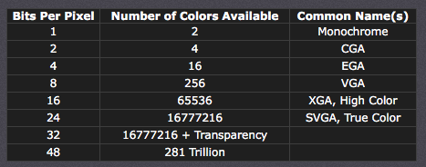
Bit Depth
How many colours are in a image

Slide 42
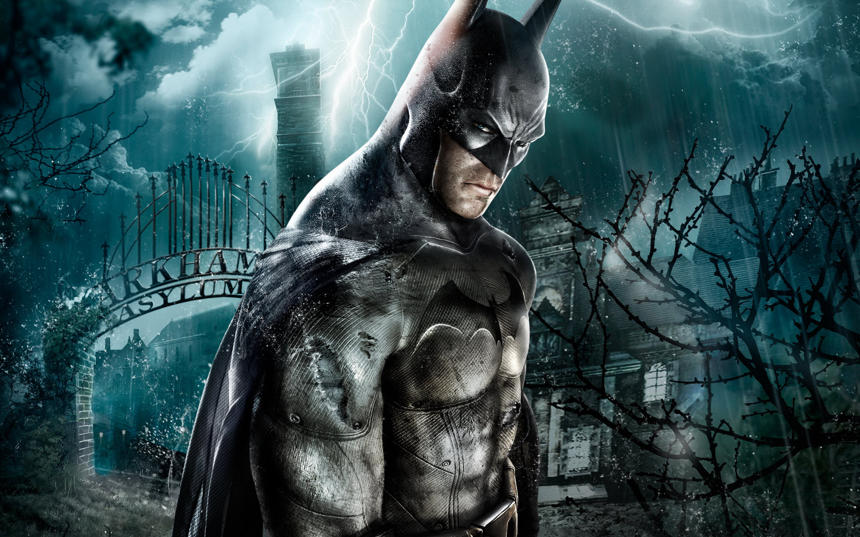
Examples
Here is a black and white image
Only has 1 bit
Which means 2 colours
2¹ = 2
So 600 x 800 x 1
480,000 bits (divide this by 8 to get..)
60,000 bytes (divide this by 1024..)
58.5 KB (divide this by 1024..)
0.05 MB
600
800

Slide 43
Examples
Here is a 16bit image
Has 65,536 colours
2¹⁶ = 65,536
So 600 x 800 x 16
7,680,000 bits (divide this by 8..)
960,000 bytes (divide by 1024)
937.5 KB (divide by 1024..)
0.9MB
600
800

Slide 44
Quick Bits
Bitmap = Uses pixels to make an image
More pixels = better resolution
When you zoom in the number of pixels stays the same – so when you zoom it loses quality
Photo realistic

Slide 45
Vector
Vector images are a different type of image
It does NOT use pixels.
It just uses maths.
Its made up of
Drawing Object
Drawing List
Property
User Space

Slide 46
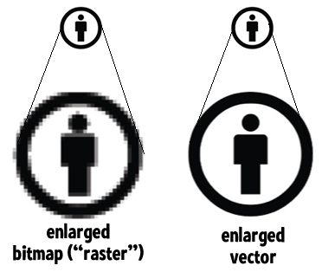
Compare to Bitmap
Because with vector you only care about drawing lines from point A to point B, when you resize the image point A and point B get adjusted accordingly

Slide 47
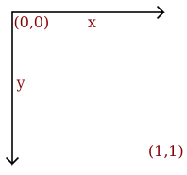
What makes a vector image?
First you need a co-ordinate system. This is called USER SPACE.

Slide 48

What makes a vector image?
draw circle
center 0.5, 0.5
radius 0.4
fill-color yellow
stroke-color black
stroke-width 0.05
draw circle
center 0.35, 0.4
radius 0.05
fill-color black
draw circle
center 0.65, 0.4
radius 0.05
fill-color black
draw line
start 0.3, 0.6
end 0.7, 0.6
stroke-color black
stroke-width 0.1

Slide 49
What makes a vector image?
Drawing Object
What you are actually drawing. Circle, Square, Text, Lines etc..
Property
The location, size, stroke and colour of the drawing object
Drawling list
What to draw in what order (what layers are first)
User Space
The area you are drawing in

Slide 50
Vector
Usually less file size
Scalable, resize and you keep the quality
Not photo realistic

Slide 51
Bitmap or Vector?
Would you pick bitmap or vector for the following?
A large poster of a human face
A business logo
Text
A cartoon character
Your ID card photo
Task
Make one image as a bitmap and the SAME image as a vector.
What are 3 similarities between using bitmap and vector software?
What are 3 differences between using bitmap and vector software?

Slide 52
1.2 Multimedia - Sound
Show understanding of how sound is represented and encoded
Show understanding of the impact of changing the sampling rate and resolution
Use the terms: sampling, sampling rate, sampling resolution, analogue and digital data
Impact on file size and accuracy

Slide 53
Today
Show understanding of how sound is represented and encoded
Show understanding of the impact of changing the sampling rate and resolution
Use the terms: sampling, sampling rate, sampling resolution, analogue and digital data
Impact on file size and accuracy
Understand: How to measure sound
Able: Calculate the file size for sounds and how to convert it into binary
Answer: What’s the difference between sampling and sample rate.

Slide 54
1.1.3 - Sound
How is sound represented
Sampling
Sampling rate
Sampling resolution
Using sound software

Slide 55
What is sound?
Which one is correct?
Sound is air particles moving
Sound are vibrations being picked up by your ear
Sound is measured by waves
All are true

Slide 56
What is sound?
If something can make a vibration, then it moves air particles around it.
These air particles then move other air particles which move other air particles
This continues until it reaches your ear
When it enters your ear then it becomes sound.
Before this – its just compression waves.

Slide 57
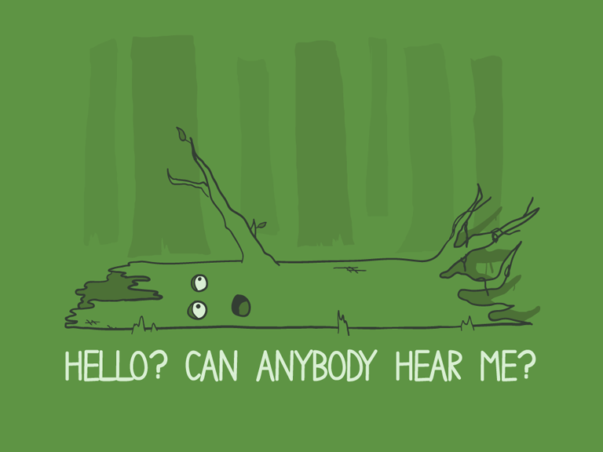
Famous Question
If a tree falls over and there is no one to hear it, does it make a sound?

Slide 58
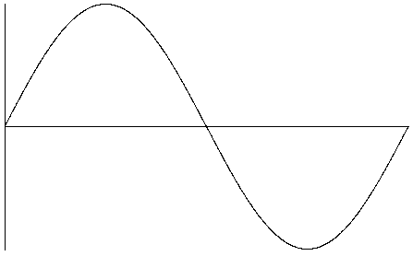
Sine wave
Sound is represented by a wave, or sine wave. It does NOT exist like this in real life, its just used to help describe sound

Slide 59
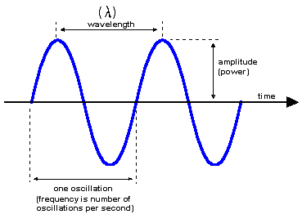
Sine wave
Amplitude – Maximum disturbance from undisturbed position
Frequency – How many times a complete wave form in 1 second
Wavelength – Distance between one crest and the next

Slide 60
Match up the statements
Sampling
Sampling rate
Sampling resolution
Number of samples taken per second
Converting a sound wave in a digital form. This take regular measurements of the sound
How many samples can be taken. 8-bit rate = 2⁸ = 256 samples
16 bit = 2¹⁶ = 65,536 samples

Slide 61
Match up the statements
Sampling
Sampling rate
Sampling resolution
Converting a sound wave in a digital form. This take regular measurements of the sound
Number of samples taken per second
How many samples can be taken. 8-bit rate = 2⁸ = 256 samples
16 bit = 2¹⁶ = 65,536 samples

Slide 62
File Size
File size (bits) =
sampling frequency (Hz) x sampling depth (bits) x
length of sound (s) x channels
Example
A stereo song has to be recorded at CD quality. The song is 4 minutes and 8 seconds long. How much disk space would the captured song occupy?
Settings for CD quality are:
Sampling frequency = 44100 Hz (44.1KHz)
Sampling depth = 16 bit
Length of song = 4 x 60 + 8 = 248 seconds
File size (bits) = 44100 x 16 x 248 x 2 = 349977600
File size (bytes) = 349977600 / 8 = 43747200
File size (kilobytes) = 43747200 / 1024 = 42721.88
File size (megabytes) = 42721.88 / 1024 = 41.72Mb

Slide 63
Questions
1. A stereo song has to be recorded at CD quality. The song is 2 minutes and 32 seconds long. What file size would the song have?
2. A stereo song has to be recorded at CD quality. The song is 4 minutes and 45 seconds long. What file size would the song have?
3. A 1 minute 15 second audio track is sampled in mono at 22.5KHz using an 8 bit sample rate. What file size would the track be?
4. A 32 second audio track is sampled in stereo at 22.5KHz using a 16 bit sample rate. What file size would the track be?

Slide 64
Task
Record / Get an audio file and export it with different sample rates and resolution to hear the difference

